Slide 1
AirInterface
LTP

Slide 2
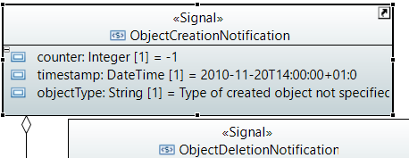
MNDI
Anstatt von /v1/notify-availability-of-new-device
SDN-Control-Domain
ControlConstruct
/v1/notify-object-creations
=> /v1/regard-object-creation
*
CC
*
Links
*
LTP
*

Slide 3
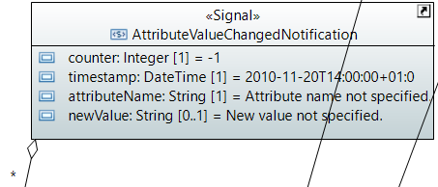
MNDI
Anstatt von /v1/notify-changed-attribute-value
SDN-Control-Domain
/layer-protocol=2146697857/air-interface-2-0:air-interface-pac/air-interface-configuration/performance-monitoring-is-on
/v1/notify-attribute-value-changes
*
=> /v1/regard-attribute-value-change
CC
*
Links
*
LTP
*

